Slide 1
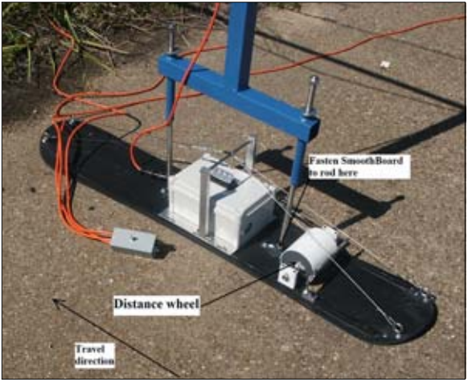
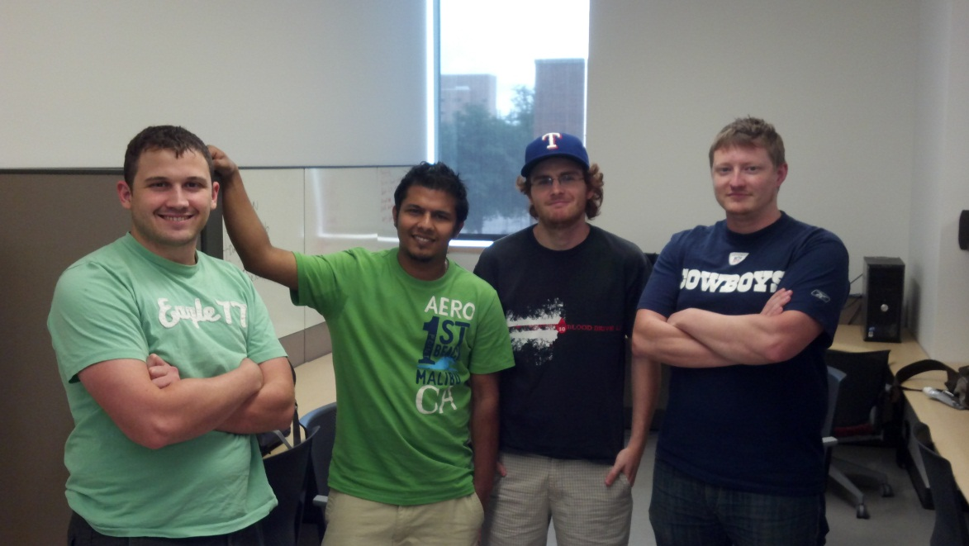
The Builders Group Ltd.
Sliding Profiler
Notes:
CM starts

Slide 2
Team Members
CM Aryal – “Dawg Ganeshpur”
(Team Lead)
Lloyd Bond – “Beaver Hercules”
Tyler Buchanan – “Penny Rachel”
Jefferson White – “Bandit Bloomfield”
Sponsor: Dr. Walker

Slide 3
Responsibilities
Dawg Ganeshpur
Integration Lead
Scheduling
Project Planner
Beaver Hercules
Procurement
Quality
Note Taker

Slide 4
Responsibilities
Penny Rachel
Documentation
Change Manager
Collaborator
Bandit Bloomfield
Presentation
Risk Management
Notes:
Last slide for CM
Hand off to Lloyd when done

Slide 5
Collaboration Plan
Communication:
Email (Primary)
Cellphones (Emergency)
Meeting Times:
Every Tuesday/Thursday after class (noon-?)
Notes:
Lloyd start

Slide 6
Becoming a Team
Team Name
Nicknames
Hang out before class
Finding similarities

Slide 7
Team Strengths
Ability to maintain focus as a team
Programming languages
Overall well-balanced
Diverse in tools
Strong leadership background
Notes:
Last slide for Lloyd
Hand off to Jeff when done

Slide 8
Team Weaknesses
Developmental methodologies
Ability to use other technologies
Finding the metrics
Multiprocessing
4 person team
Notes:
Jeff start

Slide 9
Solving Weaknesses
Developmental methodologies
Learn from experience
Technology research
Refine metrics
Multiprocessing not an issue
Higher workload expectations
Notes:
Last slide for Jeff
Hand off to Tyler when done

Slide 10
Approaching Challenges
Building efficient schedule
Project estimation
Learning required technologies
Appropriate work division
Notes:
Tyler start

Slide 11
Approaching Obstacles
Previous project failed. Make sure project meets specifications from sponsor
= Bad communication
Currently no immediate obstacles

Slide 12
Work Outlook
Continue to meet with Sponsor
Interim individual reports (6/29)
Team Reports (7/6)
ENB Review (7/6)
Notes:
Last slide

